Slide 1
Stacks
Summary of Lecture:
· What is a Stack?
· What operations can be performed on it?
· Applications

Slide 2
Introduction
There are certain frequent situations in computer science when one wants to restrict insertions and deletions so that they can take place only at the beginning or the end of the list, not in the middle.
Two of the data structures that are useful in such situations are stacks and queues.
A stack is a linear structure in which items may be added or removed only at one end.
Figure below pictures three everyday examples of such a structure: a stack of dishes, a stack of pennies and a stack of folded towels.

Slide 3
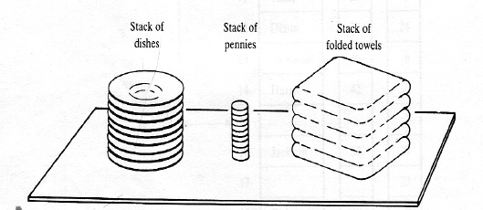
Stacks

Slide 4
Introduction
Observe that an item may be added or removed only from the top of any of the stacks. This means, in particular, that the last item to be added to a stack is the first item to be removed.
Accordingly, stacks are also called last-in first-out (LIFO) lists. Other names used for stacks are “piles” and “push-down lists.”
Although the stack may seem to be a very restricted type of data structure, it has many important applications in computer science.

Slide 5
Definition
A stack is a list of elements in which an element may be inserted or deleted only at one end, called me top of the stack. This means, in particular, that elements are removed from a stack in the reverse order of that in which they were inserted into the stack.
Special terminology is used for two basic operations associated with stacks:
(a) “Push” is the term used to insert an element into a stack.
(b)“Pop” is the term used to delete an element from a stack.

Slide 6
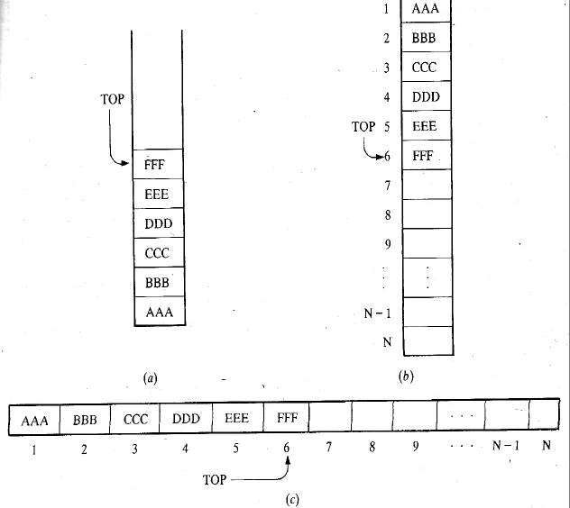
Stack..

Slide 7
Example
Example:
Suppose the following 6 elements are pushed, in order, onto an empty stack: AAA, BBB, CCC, DDD, EEE, FFF
Figure below shows three ways of picturing such a stack. For notational convenience, we will frequently designate the stack by writing:
STACK: AAA, BBB, CCC, DDD, EEE, FFF
The implication is that the right-most element is the top element. We emphasize that, regardless of the way a stack is described, its underlying property is that insertions and deletions can occur only at the top of the stack. This means EEE cannot be deleted before FFF is deleted, DDD cannot be deleted before EEE and FFF are deleted, and so on. Consequently, the elements may be popped from the stack only in the reverse order of that in which they were pushed onto the stack.

Slide 8
Postponed Decisions
Stacks are frequently used to indicate the order of the processing of data when certain steps of the processing must be postponed until other conditions are fulfilled. This is illustrated as follows.
Suppose that while processing some project A we are required to move on to project B, whose completion is required in order to complete project A. Then we place the folder containing the data of A onto a stack, as pictured in Fig. (a), and begin to process B.
However, suppose that while processing B we are led to project C, for the same reason.

Slide 9
Decisions….
Then we place B on the stack above A, as pictured in Fig. (b), and begin to process C.
Furthermore, suppose that while processing C we are likewise led to project D. Then we place C on the stack above B, as pictured in Fig. (c), and begin to process D.

Slide 10
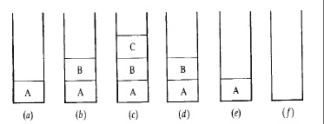
Figure..

Slide 11
Example
On the other hand, suppose we are able to complete the processing of project D. Then the only project we may continue to process is project C, which is on top of the stack.
Hence we remove folder C from the stack, leaving the stack as pictured in Fig. (d), and continue to process C. Similarly, after completing the processing of C, we remove folder B from the stack, leaving the stack as pictured in Fig. (e), and continue to process B.
Finally, after completing the processing of B, we remove the last folder, A, from the stack, leaving the empty stack pictured in Fig. ( f), and continue the processing of our original project A.

Slide 12
Stacks…
Observe that, at each stage of the above processing, the stack automatically maintains the order that is required to complete the processing.
An important example of such a processing in computer science is where A is a main program and B, C and D are subprograms called in the order given.

Slide 13
Array Representation of Stacks
Stacks may be represented in the computer in various ways, usually by means of a one-way list or a linear array.
Unless otherwise stated or implied, each of our stacks will be maintained by a linear array STACK; a pointer Variable TOP, which contains the location of the top element of the stack; and a variable MAXSTK which gives the maximum number of elements that can be held by the stack.
The condition TOP = 0 or TOP = NULL will indicate that the stack is empty.

Slide 14
example
Figure below pictures such an array representation of a stack. (For notational convenience, the array is drawn horizontally rather than vertically.)
Since TOP = 3, the stack has three-elements, XXX, YYY and ZZZ; and since MAXSTK = 8, there is room for 5 more items in the stack.
The operation of adding (pushing) an item onto a stack and the operation of removing (popping) an item from a stack may be implemented, respectively, by the following procedures, called PUSH and POP.

Slide 15
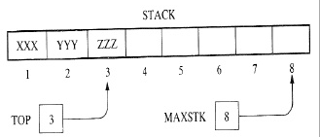
Figure..

Slide 16
Push and pop
In executing the procedure PUSH, one must first test whether there is room in the stack for the new item; if not, then we have the condition known as overflow.
Analogously, in executing the procedure POP, one must first test whether there is an element in the stack to be deleted; if not, then we have the condition known as underflow.

Slide 17
Procedure: PUSH
PUSH (STACK, TOP, MAXSTK, ITEM)
This procedure pushes an ITEM onto a stack.
1. [Stack already filled?] If TOP = MAXSTK, then: Print: OVERFLOW, and Return.
2.Set TOP: =TOP+1. [Increases TOP by 1.]
3. Set STACK [TOP]: = ITEM. [Inserts ITEM in new TOP position.
4. Return.

Slide 18
Procedure: POP
Procedure: POP (STACK, TOP, ITEM)This procedure deletes the top element of STACK and assigns it to the variable ITEM.
1. [Stack has an item to be removed?]If TOP = 0,
then: Print: UNDERFLOW, and Return.
2. Set ITEM: = STACK [TOP]. [Assigns TOP element to ITEM.]
3. Set TOP: = TOP - 1. [Decreases TOP by 1.]
4. Return.

Slide 19
Note
Frequently, TOP and MAXSTK are global variables; hence the procedures may be called using only
PUSH (ST ACK, ITEM) and POP (ST ACI5, ITEM) respectively.
We note that the value of TOP is changed before the insertion in PUSH but the value of TOP is changed after the deletion in POP.

Slide 20
Example
a. Consider the stack in previous figure. We simulate the operation PUSH (STACK, WWW):
1. Since TOP = 3, control is transferred to Step 2.
2. TOP = 3 + 1 = 4.
3. STACK [TOP] = STACK [4] = WWW.
4. Return.
Note that WWW is now the top element in the stack.
b. Consider again the same stack. This time we simulate the
operation POP (STACK, ITEM):

Slide 21
Example…
1. Since TOP = 3, control is transferred to Step 2.
2. ITEM = ZZZ.
3. TOP = 3 - 1 = 2.
4. Return.
Observe that STACK [TOP] = STACK [2] =YYY is now the top element in the stack.

Slide 22
Minimizing Overflow
There is an essential difference between underflow and overflow in dealing with stacks. Underflow depends exclusively upon the given algorithm and the given input data, and hence there is no direct control by the programmer.
Overflow, on the other hand, depends upon the arbitrary choice of the programmer for the amount of memory space reserved for each stack, and this choice does influence the number of times overflow may occur.

Slide 23
Implementation of stack using Java
In Java a stack ADT can be implemented using an array with the following operations/methods
push(obj): Add object obj at the top of the stack.
Input: Object; Output: None.
obj pop(): Delete an item from the top of the stack and returns object obj; an error occurs if the stack is empty.
Input: None; Output: Object.

Slide 24
Stack implementation…
obj peek(): Returns the top object obj on the stack , without removing it; an error occurs if the stack is empty.
Input: None; Output: Object.
boolean isEmpty(): Returns a boolean indicating if the stack is empty.
Input: None; Output: boolean (true or false).
int size(): Returns the number of items on the stack.
Input: None; Output: integer.

Slide 25
Stack interface
public interfaceStack
{ public void push(Object ob);
public Object pop();
public Object peek();
public boolean isEmpty();
public int size();
}

Slide 26
Create stack
public class ArrayStack implements Stack
{
private Object a[];
private int top; // stack top
public ArrayStack(int n) // constructor
{ a = new Object[n]; // create stack array
top = -1; // no items in the stack
}

Slide 27
Push
public void push(Object item) // add an item on top of stack
{
if(top == a.length-1)
{ System.out.println("Stack is full");
return;
}
top++; // increment top
a[top] = item; // insert an item
}

Slide 28
Pop
public Object pop() // remove an item from top of stack
{
if( isEmpty() )
{ System.out.println("Stack is empty");
return null;
}
Object item = a[top]; // access top item
top--; // decrement top
return item;
}

Slide 29
Peek, empty and size
public Object peek() // get top item of stack
{ if( isEmpty() ) return null;
return a[top];
}
public boolean isEmpty() // true if stack is empty
{ return (top == -1); }
public int size() // returns number of items in the stack
{ return top+1; }
}

Slide 30
Testing the stack
class ArrayStackDemo
{
public static void main(String[] args)
{
ArrayStack stk = new ArrayStack(4); // create stack of size 4
Object item;
stk.push('A'); // push 3 items onto stack
stk.push('B');
stk.push('C');
System.out.println("size(): "+ stk.size());
item = stk.pop(); // delete item

Slide 31
Test…
System.out.println(item + " is deleted");
stk.push('D'); // add three more items to the stack
stk.push('E');
stk.push('F');
System.out.println(stk.pop() + " is deleted");
stk.push('G'); // push one item
item = stk.peek(); // get top item from the stack
System.out.println(item + " is on top of stack");
}
}
Write the output of this program

Slide 32
Applications of stacks
They are used to evaluate postfix, infix and prefix expressions
Backtracking algorithm used in game playing, finding paths or exhaustive searching
Memory management, run-time environment for nested language features.

Slide 33
The end

